Slide 1

Sprint Planning meeting

Slide 2
Objectives
To Understand
What Sprint Planning Meeting
Who Attends
Team Velocity
How to Select DoR product backlog features- to be moved to the sprint backlog

Slide 3
Sprint Planning Meeting
Sprint planning meeting
This meeting is held at the beginning of the sprint.
The meeting will usually take the full day for a two-week sprint and is split into two sections (what and how).
The first half of the meeting is where the team decide what is going to be brought into the sprint backlog.
The second half of the meeting is where the team decide how the items they have brought in are going to be completed, usually by further breaking down the tasks into smaller pieces and adding technical details.

Slide 4
Attendees
Roles attending the Sprint Planning Meeting
Product Owner
Scrum Master
Development Team Members
Stakeholder (as required)
The Scrum Master organises this meeting and sends out the invites.

Slide 5
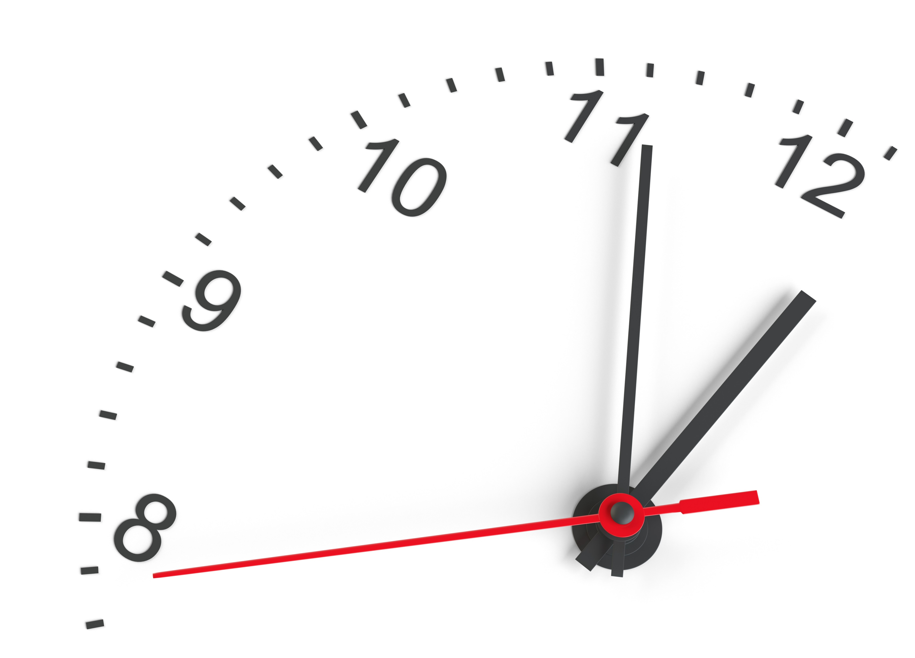
Estimating In Agile
Agile Teams do not use time as a measurement for estimating when a feature will be in the DoD state.
The team estimates a feature relative to others
Asks is this item a Small , Medium or Large item, then it is placed in the Small medium or Large buckets

Slide 6
Estimating in agile
When estimating a feature, the team will spend time examining the feature to determine which bucket it should be placed in. This:-
Drives out clarification questions
Highlights complex and high-risk tasks.
This helps to drive out further requirements that will need to be met to complete the feature. It brings the conversations to answer these questions.

Slide 7
Time
How long does it take to
Importance
Set the Priority
Understand
Read through the User story and understand it completely
Plan
Produce a plan of action (use existing modules, how to test...)
Code
Write the code
Test
Write Unit tests for the code
Integrate
Integrate (merge) it with the rest of the project code (GIT)
System Test
Deployment: locally, test server, on company server, cloud
Things to think about

Slide 8
Common Estimation techniques
bus
Big / UnCertain / Small (BUS)
Each user story is compared to the others and assigned to one of the groups.
Big stories should be broken down into smaller stories- if possible
Uncertain stories need to be examined and again broken down into smaller stories
Small stories are bite size and easy to complete and provide value

Slide 9
Common Estimation techniques
T-Shirt sizes
Typical T-Shirt sizes are
XS, S, M, L, XL
Each story is compared against the other stories and given a T-shirt size.
L and XL stories should be broken down into smaller user stories if possible

Slide 10

Common Estimation techniques
Fibonacci sequence
Fibonacci Sequence
Abstract value represents the size of the feature
1, 2, 3, 5, 8, 13, 21… (numbers over 21 are rare)
Each story is compared to the other stories in the project and is assigned “Story Points”
Stories with Larger story points should be broken down if possible
The number of story points that can be worked per sprint is the team’s velocity.
This Photo by Unknown Author is licensed under CC BY
Notes:
https://www.knowledgehut.com/blog/agile/fibonacci-series-for-estimation
A general practice from matured Agile teams is that the Fibonacci sequence is restricted up to 21 (0,1,1,2,3,5,8,13,21) and any story which is of size beyond 21 will have to be broken down further. This ensures that the team is not giving any room for greater uncertainty and good practice for the team to write better stories under the INVEST guidelines.
It becomes increasingly difficult to discriminate between two numbers as the difference between them decreases.
The smaller value assigned from the Fibonacci sequence to a user story usually means that the story is well understood, and the user story follows INVEST (Independent, Negotiable, Valuable, Estimable, Small and Testable) guidelines. Whereas the largest value denotes the story is not well understood or it needs to be broken down further. Smaller stories can be confidently estimated by the team in detail.

Slide 11
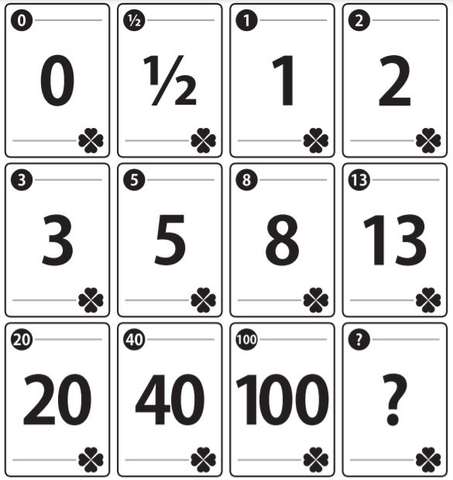
Planning Poker is a collaborative estimation technique used Agile
Prepare a set of Planning Poker cards with values such as 0, 1, 2, 3, 5, 8, 13, 20, 40, 100, etc for story points
Each team member selects a card that represents their estimate for the effort required to complete the user story.
This is done privately to avoid influence from others.
Reveal all cards simultaneously.
Team members adjust their estimates by selecting another card.
Re-estimation continues until a consensus is reached.
Planning poker
This Photo by Unknown Author is licensed under CC BY-SA

Slide 12
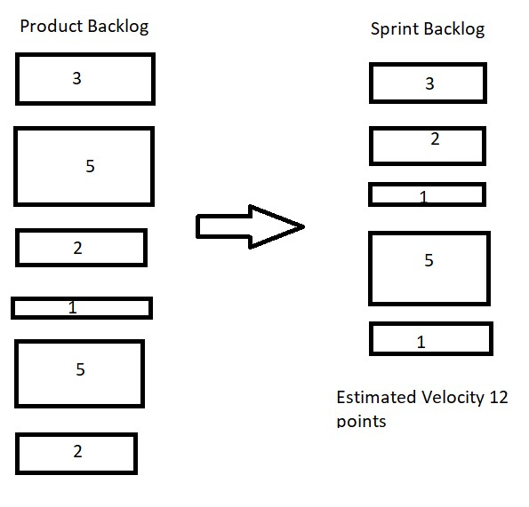
Team Velocity
Team Velocity
On average:-
How many story points can the team complete in a given sprint.

Slide 13
Team Velocity
Team Velocity
When a sprint is completed, you will have the actual velocity of the team.
Any stories not completed can be moved back to the product backlog, ready for the next Sprint Planning Meeting
Over time you will be able to use the velocity of completed sprints to better estimate team velocity

Slide 14

Review
You Understand
What Sprint Planning Meeting
Who Attends
How to Select DoR product backlog features- to be moved to the sprint backlog
Estimate in Agile
BUS (Big / Uncertain / Small)
T-Size
Fibonacci Sequence

Slide 15
Complete Lab8
Duration 60 minutes
Lab

